Slide 1
PROJECT TITLE: FAITHPATH
BY: HAPPINESS GODKNOWS JEREMIAH
GITHUB USERNAME:jeremiahhappiness998-afk
EDX USERNAME:happiness_868
COUNTRY: NIGERIA
CITY: JOS
DATE_RECOEDED:12/31/2025
SUBMITING TO: CS50X 2025.

Slide 2
PROJECT SUMMARY:
This project is for the following objective;
A secure Web APP for collecting user prayers and Expectations personal for a user only.
It has a secure login and register page for authentication
It uses Javascript for fetch information from the template using POST and communicating with the server
It helps user track their Faith life
It has a Word of encouragement, though hard coded (i.e without an API KEY (though it will be improved later))
And it is currently under further improvement for final deployment.

Slide 3
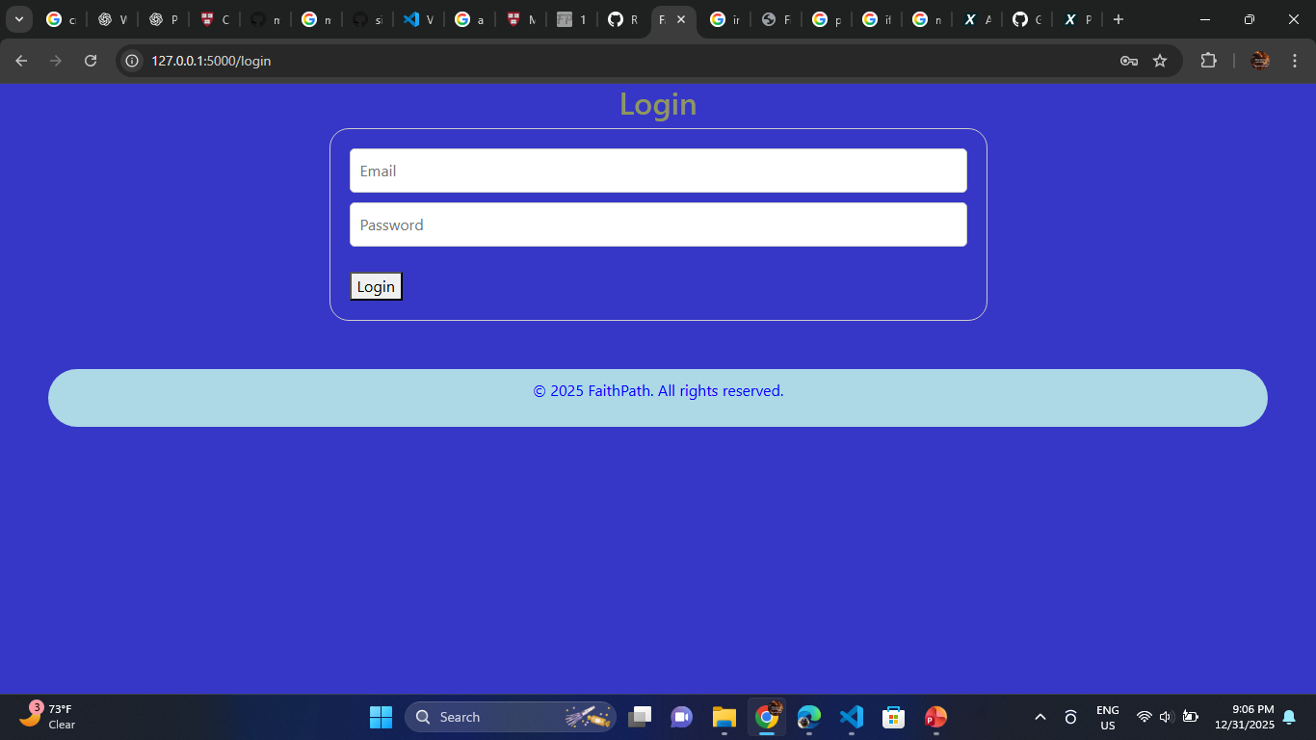
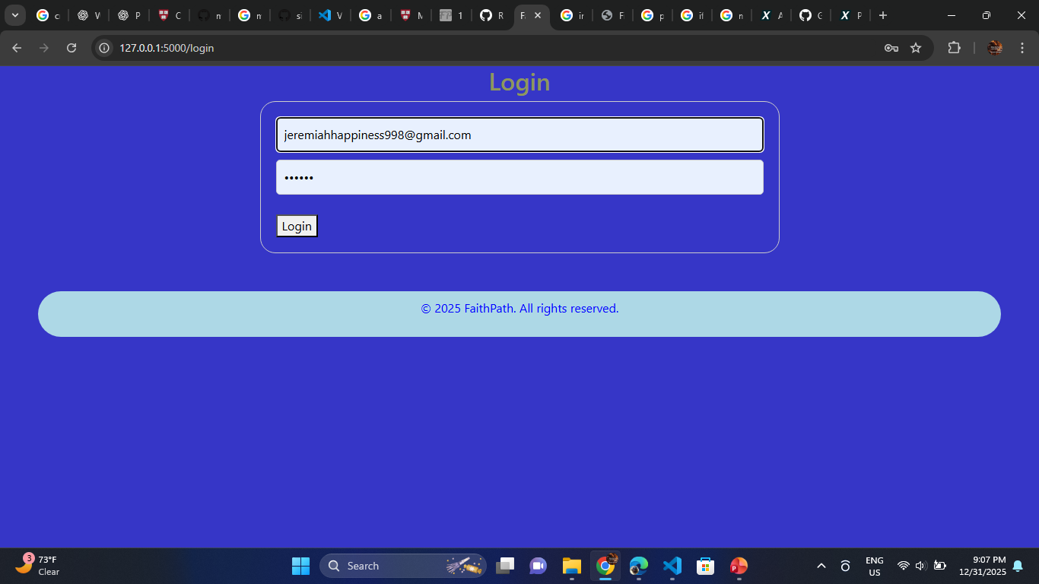
Login page;

Slide 4
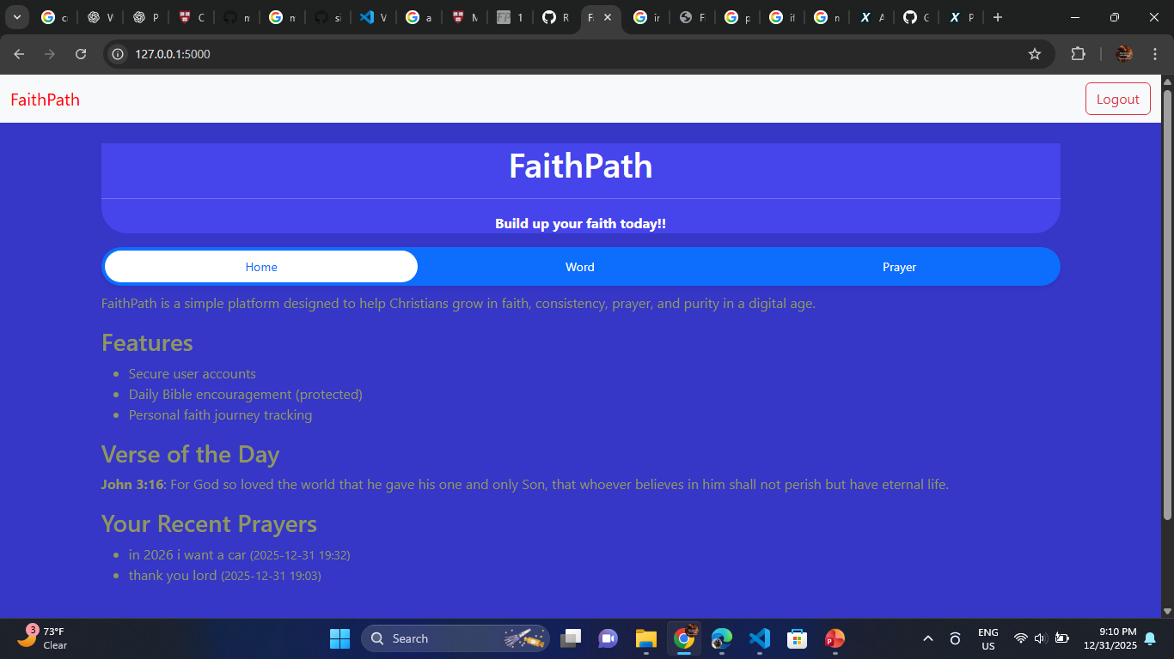
Homepage;

Slide 5
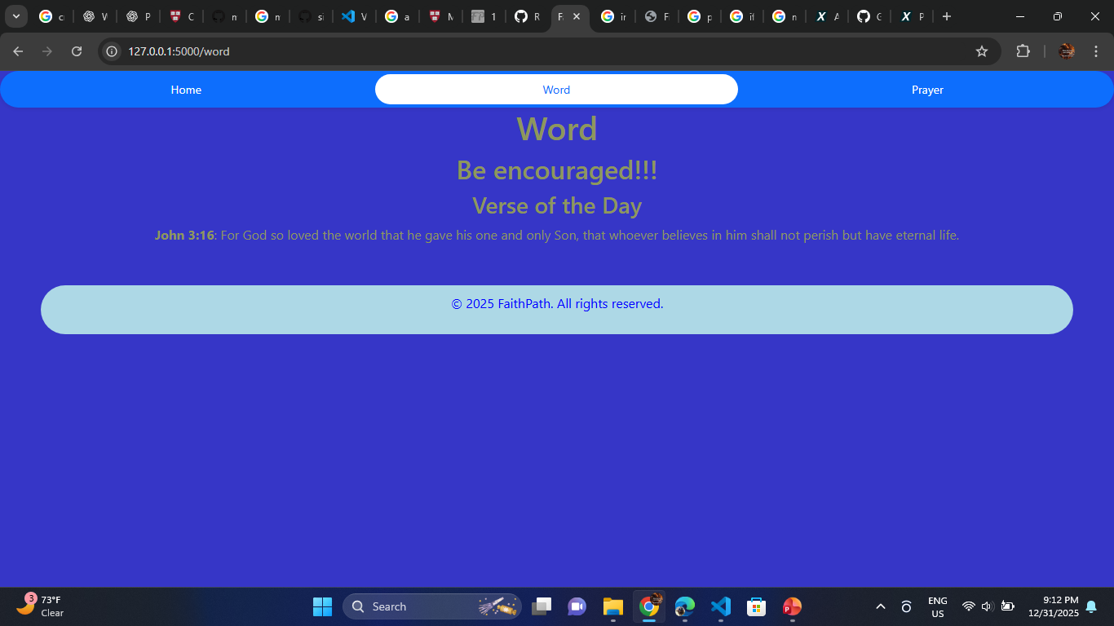
Word page

Slide 6
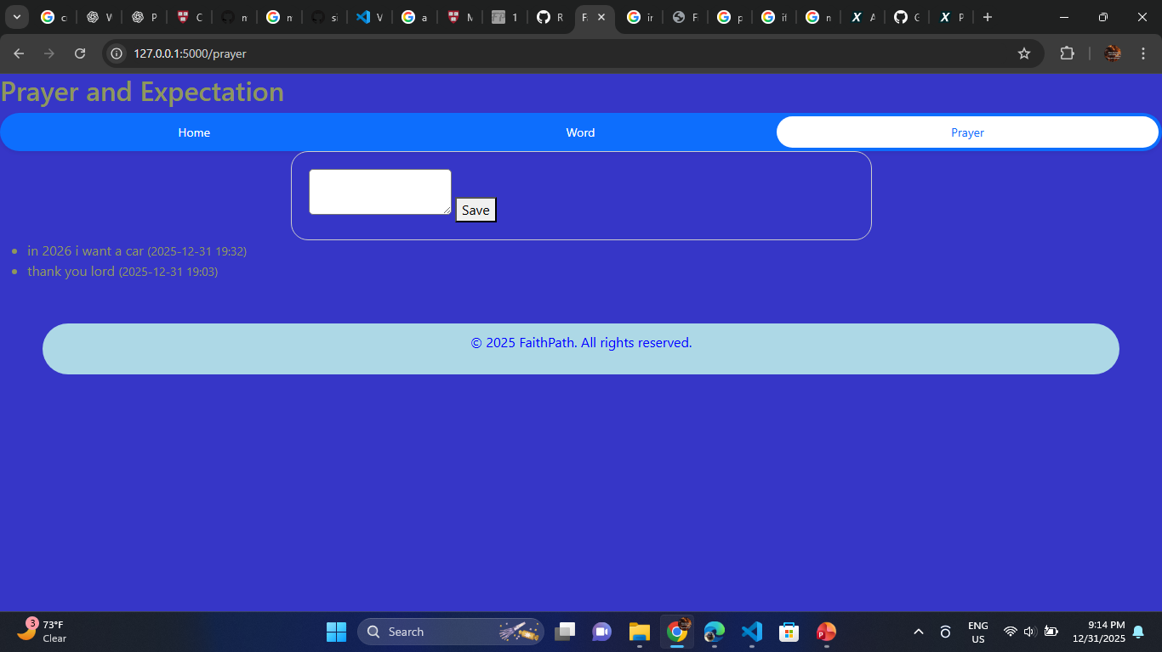
Word page

Slide 7
THANK YOU

